Slide 1

FINANCIAL TECHNOLOGY OF THE MODERN AGE: POLICY IMPLICATIONS AND NEW TRADE-OFFS
Date: 18/04/2023
Tuesday
Macerata, Italy
University of Macerata
Guided by :
Dr. Nicoletta Marinelli
Presented by :
Sachin Rajendrakumar Raval
Matriculation Number: 100284

Slide 2
Introduction
The rise of FinTech has revolutionized the financial sector, improving the speed and convenience of monetary transactions. The pandemic has accelerated this trend, with more people using digital payments and online banking. FinTech businesses have disrupted traditional financial institutions by offering various services such as mobile payment processing, crowdsourcing, financing, insurance, and asset management. Despite its growth, FinTech faces limitations in reaching underprivileged communities in developing nations without access to mobile phones or the internet. However, the introduction of new innovations also brings regulatory challenges and trade-offs, as governments must balance regulation and innovation to protect consumers and maintain the stability of the financial system. The expansion of the FinTech industry presents challenges in balancing innovation, consumer protection, financial stability, and inclusion through policy. As traditional financial institutions adopt FinTech, the competitive landscape of the financial services sector is changing, creating both new costs and benefits.

Slide 3
Modern Age of Financial Technology (FinTech)
Availability of mobile devices and the internet, FinTech companies have been able to offer consumers access to financial services at any time and from anywhere.
PayTech: The payments and transfers component is a critical part of the FinTech infrastructure as it is the gateway to all financial transactions.
RegTech: RegTech is set to shape the future of the European FinTech market.
Open Finance (The Future of Data Sharing): FinTech heavily relies on data, and there is a growing demand for data sharing between financial service providers and FinTech companies.
Open Banking: The emergence of open banking permits third-party providers to access financial information and provide novel services to customers.
Artificial Intelligence: Leverages computers and machines to mimic the problem-solving and decision-making capabilities of the human mind.
AI-powered Chatbots: Assist customers with their queries and requests.
Machine Learning: Algorithms analyze a large amount of data to identify and classify patterns and perceptions that can inform business decisions.
Blockchain: Core technology of FinTech. allows a person to safely send money to another person without going through a bank or financial services provider. Many in the financial services industry refer to blockchain technology as distributed ledger technology.
Big Data: Leveraging big data and analytics to offer customers more personalized and targeted facilities and services.
Peer-to-peer: Lending uses online platforms to directly connect people who want to borrow money with people who want to lend money. allowing individuals to raise money for a specific project.
Digital-only or Neobanks: These offer customers a range of services such as current accounts, payments, and lending, all through a mobile app or website.

Slide 4
International Financial Technology Market (IFinTech) and Core Infrastructures
Traditional financial institutions often struggle with outdated systems and long wait times, which can frustrate customers. FinTech companies, on the other hand, have developed solutions that prioritize customer satisfaction and offer faster, more efficient services.
Data is the lifeblood of FinTech companies, enabling them to develop innovative products, and services and enhance customer experience.
The global FinTech market industry is projected to be worth $460 billion by 2025. It can be divided into several categories, with payments experiencing the most significant growth. FinTech has the potential to improve financial inclusion and add $250 billion to the GDP of emerging economies.
Key FinTech players in Europe include Revolut, TransferWise, Adyen, Klarna, and N26, which offer a range of digital banking services and disrupt traditional financial services. Europe has a large number of innovative companies based in cities such as London, Berlin, and Stockholm. The European FinTech market is expected to grow rapidly, with the UK, Germany, and France dominating but other countries emerging as new FinTech hubs.
The core infrastructure of FinTech ecosystems comprises several components, including payments and transfers, lending, wealth management, insurance, and regulatory compliance.
The growth of FinTech in Europe has been remarkable, with start-ups raising millions of dollars in investments and receiving regulatory support for open banking. However, there are challenges, such as regulatory fragmentation. By 2025, retail banking revenues in Europe are predicted to be up to 60% from FinTech.
FinTech innovations have created opportunities for collaboration between established banks and innovative FinTech companies.
Financial Inclusion " refers to the availability and equality of opportunities to access financial services. financial inclusion majorly through mobile financial technology.

Slide 5
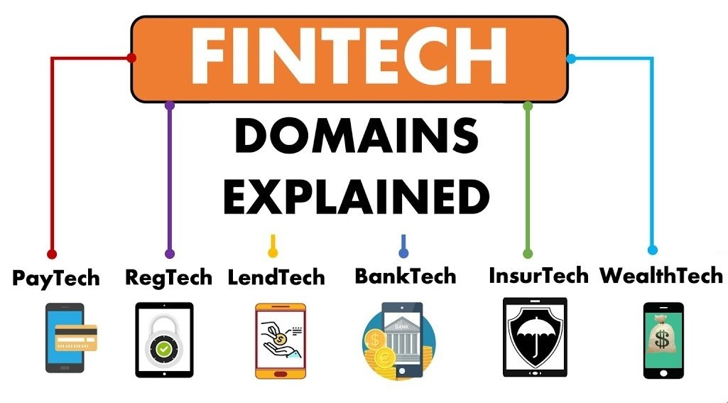
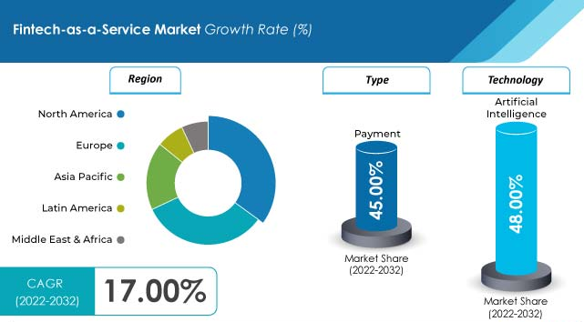
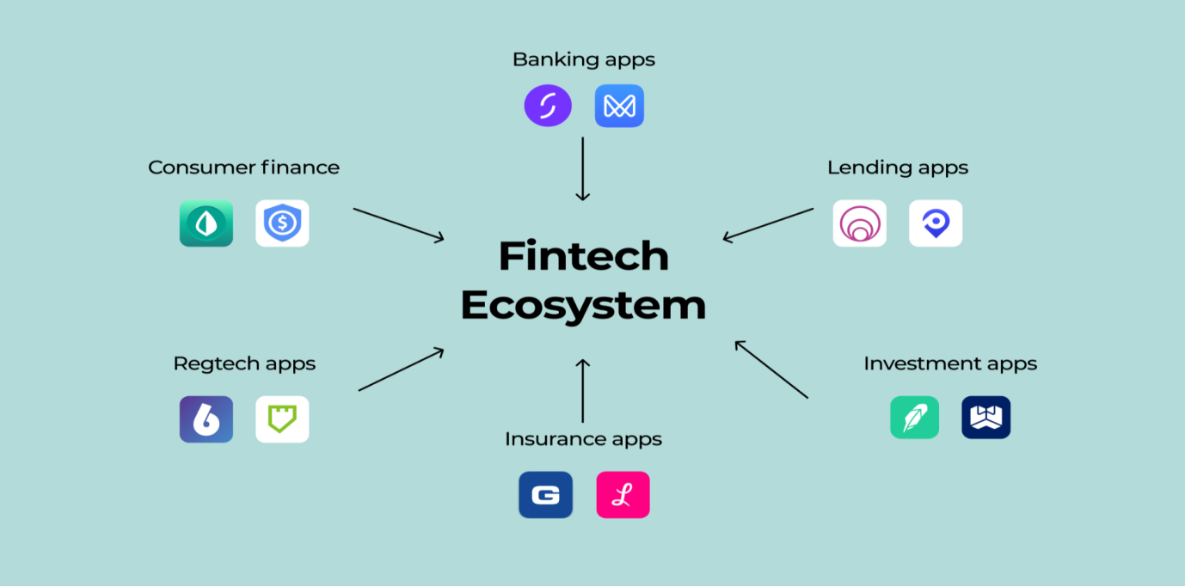
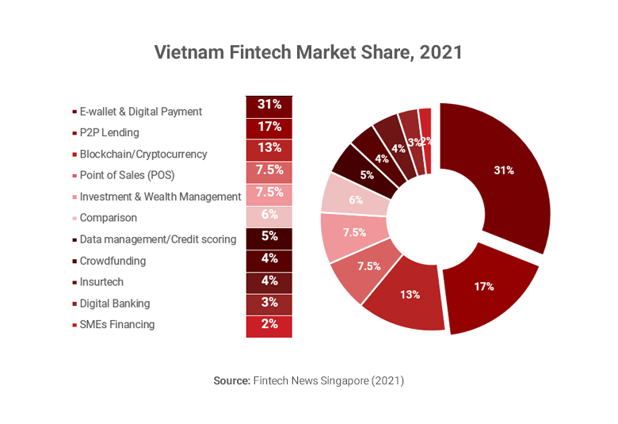

Slide 6
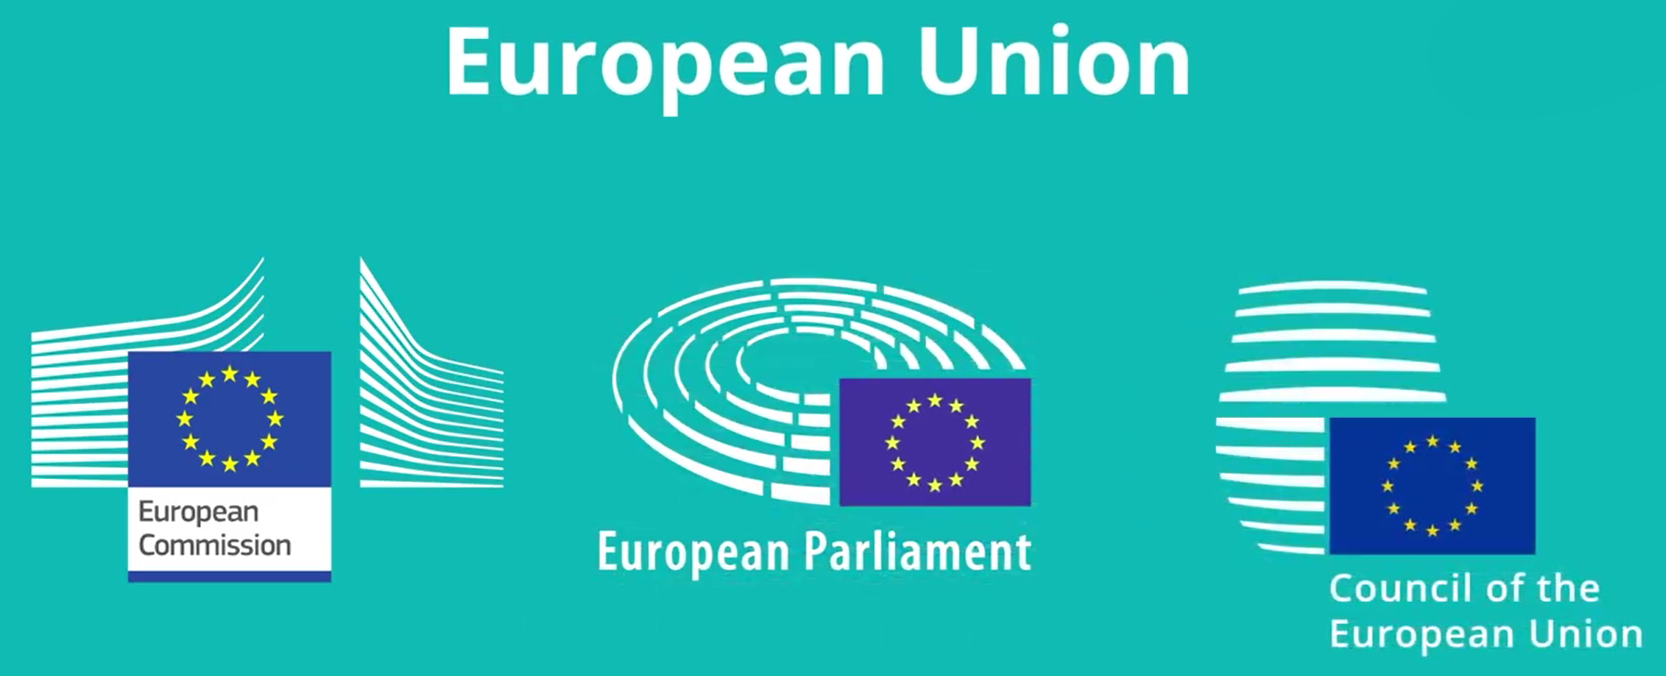
European Union Regulatory Roadmap
EU Payment Services Directive 2 (8 October 2015 by the EC): Banks must share client data with third-party beneficiaries, and the directive provides a regulatory framework for payment service providers, including FinTech companies.
EU General Data Protection Regulation (25 May 2018 by the EC): GDPR regulates personal data collection, storage, and utilization by companies, including FinTech firms, to protect consumer data privacy. It includes measures like the right to access, control, and forget personal data and strict rules on data breaches. Provides a framework for data privacy that applies to all companies operating in Europe, including FinTech.
European Banking Authority: EBA coordinates EU-wide banking supervision and ensures high cybersecurity standards in the EU banking sector. 80% of European banks have started FinTech-related activities.
Euro system's FinTech Forum: Aims to foster dialogue between the European Central Bank and the FinTech industry.
Europe's vibrant start-up Ecosystem: An important platform for the progress of fintech in the region, as it fosters competition, collaboration, and innovation.
EU FinTech Action Plan and the European Commission’s FinTech Lab: These initiatives aim to create a regulatory structure that is both supportive of innovation and effective in protecting consumers.
EC FinTech Strategy 2018: This presented a framework for building a more competitive and innovative financial industry in Europe while guaranteeing consumer protection and market integrity.

Slide 7
The UK's “Financial Conduct Authority (FCA): A leader in FinTech regulation, having launched a regulatory sandbox in 2016 and granted licenses to multiple FinTech firms. Its plan includes a single market for FinTech, a regulatory sandbox for testing, and a European FinTech labeling regime.
EU Regulatory Sandbox Framework Approach: A regulatory sandbox provides a safe environment for FinTech startups to test innovative products and services without being fully subject to regulatory requirements.
Capital Markets Union: The CMU aims to establish a single market for capital in the EU by harmonizing regulations and lowering cross-border investment barriers.
Monetary Policy: As FinTech firms offer new payment methods and services, they can affect the flow of currency and the velocity of money. as central banks must ensure that the money supply is appropriate for economic conditions. Therefore, policymakers must be aware of FinTech's possible effects on the currency market and make necessary adjustments.
EU's Cyber Security Act of 2019 established the “European Union Agency” for Cyber Security (ENISA): To improve cyber security across the EU through collaboration with member states and the private sector.
Cyber-security Standards: Cybersecurity standards promote best practices and secure network building.
The Network and Information Security Directive: The NIS Directive requires companies to secure their networks and report cyber incidents.

Slide 8
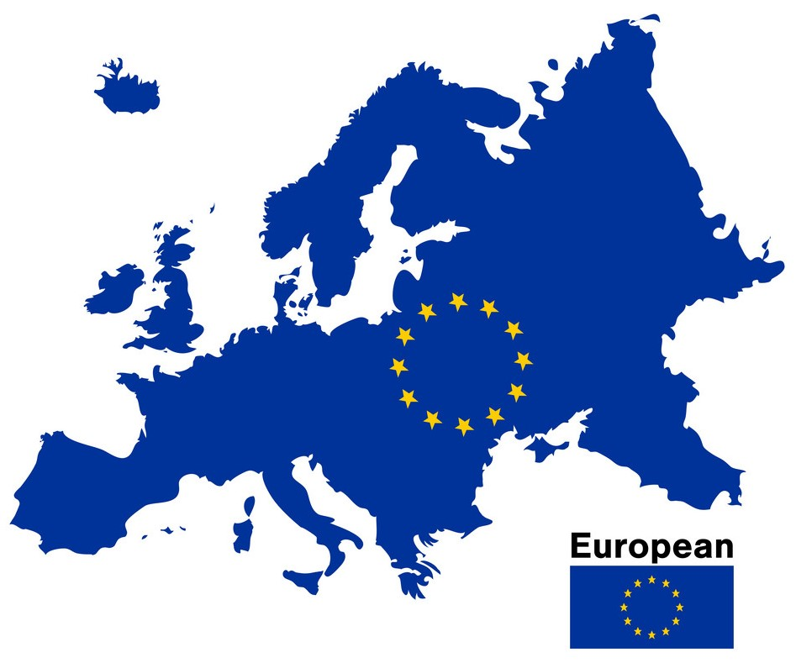
The FinTech Regulation Framework
Policy Implications of FinTech
FinTech policy refers to rules and regulations for FinTech companies to operate in a safe, secure, and fair manner while promoting innovation and competition in the financial sector.
FinTech policy covers areas such as licensing, consumer protection, data privacy and security, anti-money laundering, counter-terrorism financing, and cyber security measures.
Consumer protection measures aim to ensure fair and transparent financial services and access to information about risks associated with FinTech products and services.
FinTech policy also aims to prevent financial crime and promote financial stability.
FinTech has significant consequences for the financial industry and economy, and policymakers have a critical role to play in nurturing a favorable environment for FinTech innovation to thrive.
The growth of FinTech in Europe has raised policy concerns for regulators and policymakers.
The challenges include regulating the rapidly evolving FinTech sector, ensuring appropriate regulatory oversight, and protecting consumers.
Regulators in Europe are developing a coordinated approach to FinTech regulation to create a regulatory structure that is supportive of innovation and effective in protecting consumers.
The framework for FinTech includes strong consumer protection measures, a framework for data privacy, and measures to promote financial stability.
While FinTech has the potential to deliver significant benefits, it also poses risks and challenges that require careful consideration.

Slide 9
FinTech Policy Trade-offs
FinTech policy trade-offs refer to the challenges policymakers face when creating regulatory frameworks that balance innovation and competition with consumer protection and financial stability.
The main trade-offs include innovation vs. consumer protection, innovation vs. financial stability, innovation vs. competition, privacy and data protection, and innovation vs. financial inclusion.
The EU has adopted a technology-neutral approach to regulation and implemented a regulatory sandbox framework to promote innovation while ensuring consumer protection and financial stability.
The EU still faces challenges in harmonizing its regulatory framework across member states and balancing innovation with consumer protection.
Policymakers must continue to monitor FinTech developments and adjust policies to maximize the benefits of FinTech while minimizing risks.

Slide 10
Prevention of FinTech Fraud in Europe
The rapid growth of FinTech in Europe has made it vulnerable to fraudulent activities that can harm both businesses and consumers. To prevent FinTech fraud, companies can adopt the following measures:
  Effective identity verification processes, including biometric identification, facial recognition, and AI to detect unusual behavior patterns.
  Encryption and secure data storage methods to protect sensitive data, regularly updating security protocols in response to new threats and vulnerabilities.
  Strong anti-money-laundering and know-your-customer (KYC) rules to verify identities and monitor transactions for suspicious activity.
  Partnering with established financial institutions to leverage their expertise in fraud prevention, sharing data and insights on fraudulent activity, and collaborating on developing new security measures.
  Consumer education and awareness campaigns to inform customers on how to protect themselves from fraud, such as avoiding phishing scams and using secure passwords.
By adopting a multi-faceted approach, FinTech companies can prevent fraud, build trust with customers, and ensure the safety of financial transactions.

Slide 11


Case Studies : Revolut and N26
July 1, 2015
Case Study 1: Revolut
Revolut, a UK-based fintech company, offers banking, currency exchange, and cryptocurrency trading services, disrupting traditional banks in Europe with low costs and cutting-edge services.
Revolut's business model, while beneficial for customers, presents regulatory difficulties, particularly in the unregulated cryptocurrency industry.
Despite the limitations, Revolut has successfully attracted millions of users and has driven traditional financial institutions to adapt to the changing market conditions.
The Revolut case study highlights the challenges of balancing innovation and customer protection in the rapidly developing fintech industry.
Case Study 2: N26
N26, a German-based fintech startup, provides digital banking services throughout Europe and has experienced significant growth due to user-friendly design and tempting features.
Compliance with regulations, fierce competition, and technical challenges were among the challenges faced by N26 while scaling its platform.
N26 invested in customer service, offered new choices, such as insurance and investment products, and developed a flexible cloud-based platform to overcome these challenges.
Despite the obstacles, N26 has achieved success by serving over 7 million customers in 25 European countries and raising over $800 million in funding, highlighting the constraints of growth in the competitive European fintech market.
February, 2013

Slide 12
Key Challenges
Many FinTech companies operate across borders, which can create trials and challenges for regulators in terms of jurisdiction and coordination.
FinTech has disrupted the traditional financial industry, creating both opportunities and challenges.
FinTech also poses challenges to data privacy and cybersecurity.
This rapid growth has brought about numerous challenges, particularly in terms of regulation and compliance.
Challenge of regulating FinTech in Europe is the fragmented nature of the market.
The Challenge cost of compliance, which can be a significant burden for FinTech startups, particularly those with limited resources.
Funding is also a challenge for many FinTech market players.
Heavy reliance on talent acquisition, retention, partnerships, and collaborations are key challenges in FinTech.
The rapid development of FinTech has also introduced new challenges to competition policy.
A challenge is keeping up with the rapid pace of innovation in FinTech.

Slide 13
Result
FinTech has been revolutionizing the financial industry by providing innovative solutions that offer faster, more efficient more choice, and cost-effective services to Consumers and businesses.
Round-the-clock access to financial services through fintech innovation has enhanced the overall customer experience and raised the quality of life for consumers.
Open banking systems promoting the disclosure of financial information to approved FinTech firms are gaining momentum.
FinTech regulation and compliance are essential for promoting innovation and competition in the financial services industry.
The Growth of FinTech is set to continue, driven by the increasing demand for innovative and convenient financial services.
As technology progresses and customer expectations evolve, FinTech is expected to play a significant role in shaping the future of finance.
FinTech companies could provide financial services to many people who were previously excluded from the formal financial system. This has increased economic activity and improved the living standards of the countries.

Slide 14
Conclusion
Europe's FinTech sector is poised for significant growth in the coming years. FinTech has disrupted the traditional financial services industry with innovative products and services. Factors driving growth in the FinTech industry include rising smartphone use, increasing focus on regulatory compliance, and the worldwide outbreak of COVID-19. The future of FinTech in Europe includes the expanding application of AI and ML, increasing focus on sustainability and responsible investing, open banking, and the increasing use of blockchain technology. FinTech firms are well-positioned to provide innovative solutions that can transform financial services and benefit the economy, businesses, and customers as a whole.
The study identifies key areas for further research in FinTech regulation and compliance, including the impact on traditional financial institutions, data protection, global standards for FinTech regulation, regulatory sandboxes, financial inclusion, and financial stability, and highlights the need for collaboration between researchers and regulatory authorities to address these challenges and promote industry growth.

Slide 15
Thank you for your attention !!!
Grazie per la tua attenzione !!!

